Slide 1

Operating System (18CS43)
Module 1
What OS do; computer system organization; computer system Architecture; OS structure; OS operations; process management; memory management; storage management; protection & security; distributed system; special purpose system; computing system. Operations system services;
T S Bhagavath Singh
Associate Professor
RNS INSTITUTE OF TECHNOLOGY
DEPARTMENT OF INFORMATION SCIENCE AND ENGINEERING
CHANNASANDRA, RR NAGAR POST
Dr. VISHNUVARDHAN ROAD
BENGALURU – 560 098
rnsit.tpo@gmail.com

Slide 2
Operating System
• An Operating System (OS) is system software that manages the computer hardware.
It provides a basis for application programs and acts as an intermediary between the computer users and the computer hardware.
The purpose of an OS is to provide an environment in which the user can execute the program in a convenient & efficient manner.

Slide 3
Operating System
What Operating Systems do?
A computer system can be divided into four components
Hardware: The Hardware consists of memory, CPU, ALU, I/O devices, peripherals devices & storage devices.
OS: The OS controls & co-ordinates the use of hardware among various application programs for various users.
Application Program: The application programs includes word processors, spread sheets, compilers & web browsers which defines the ways in which the resources are used to solve the problems of the users.
User: Who works/executes the required function.

Slide 4
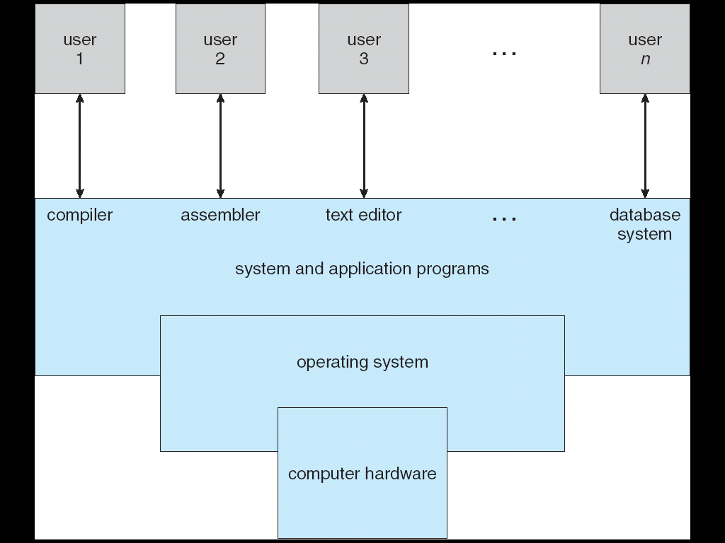
Operating System
The following figure shows the abstract view of the components of a computer system

Slide 5
Operating System
To completely understand the role of operating system two views are considered as below:
1. User View
2. System View
1. User View:
The user view of the computer depends on the interface used.
Some users may use PC’s. Such system is designed for one user
Here the OS is designed for ease of use where some attention is mainly on performances and not on the resource utilization.

Slide 6
User View cont..
Some users may use a terminal connected to a mainframe or minicomputers. Other users may access the same computer through other terminals. These users may share resources and exchange information. In this case the OS is designed to maximize resource utilization- so that all available CPU time, memory & I/O are used efficiently.
Other users may sit at workstations, connected to the networks of other workstation and servers. In this case OS is designed to compromise between individual usability & resource utilization.

Slide 7
2. System View
An operating system can be viewed as resource allocator.
A computer system has many resources such as CPU Time, memory space, file storage space, I/O devices and so on that may be used to solve a problem.
The OS acts as a manager of these resources and decides how to allocate these resources to programs and the users so that it can operate the computer system efficiently and fairly.
A different view of an OS is that it controls various I/O devices & user programs i.e., an OS is a control program which manages the execution of user programs to prevent errors and improper use of the computer.

Slide 8
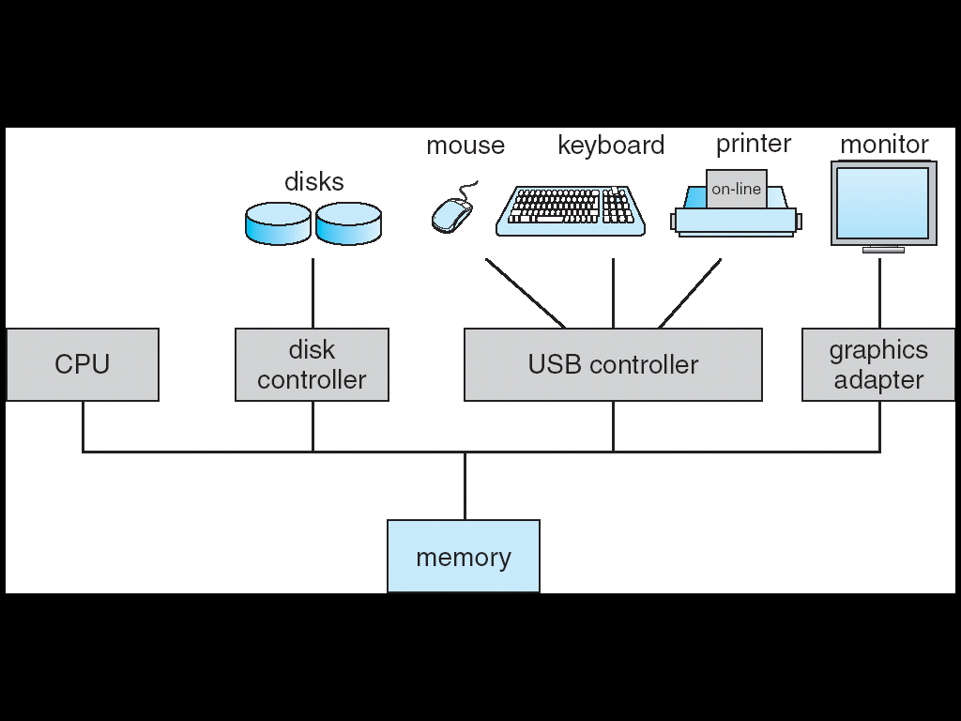
Computer system operation
A general-purpose computer system consists of one or more CPUs and device controllers connected through common bus providing access to shared memory as shown in below figure.

Slide 9
Computer system operation
CPUs and device controllers can execute concurrently competing for memory utilization and memory controller synchronizes the memory access.
Bootstrap program is loaded first. It is stored in ROM or EEPROM, generally known as firmware.
First process, called “init” is executed and waits for some event to occur.
An operating system is interrupt driven.
Each computer has its own interrupt design mechanism, but several functions are common.

Slide 10
Storage Structure
Main memory is the large storage media that the CPU can access directly. But it is very small and volatile storage device.
Computer systems have secondary storage that provides large nonvolatile storage capacity.
Magnetic disks are the common secondary storage devices. Other storage devices are cache memory, CD-ROM, magnetic tapes and so on.
Storage system is differentiated based on their speed, cost and volatility.

Slide 11
Storage Structure
Storage systems above electronic disks are volatile, expensive but fast. Below are non-volatile, comparatively cheap and slower.
Electronic disks can be treated as both volatile and non-volatile. E.g.. Flash memory used in cameras, robot and Personal Digital Assistants (PDA).
NVRAM (Non Volatile RAM) is a DRAM with a battery backup power.
Storage systems can be organized in a hierarchy as shown below in figure. according to speed and cost.

Slide 12
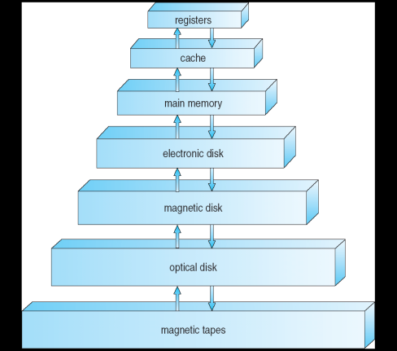
Storage Structure

Slide 13
I/O Structure
OS spends considerable amount of time in managing I/O devices because they have an impact on the performance and reliability of the system.
There is one device driver for each device controller. Each device controller maintains a buffer and registers.
When an I/O operation is started, the device driver loads the appropriate registers within the device controller. The device controller examines the contents of the registers and determines what action to be taken.
The controller starts transfer of data from the device to the local buffer.

Slide 14
I/O Structure
Once the transfer is complete the device controller informs the device driver via an interrupt that the operation is complete. The device driver then returns control to the OS through an interrupt.
This form of interrupt driven I/O works well for moving small amounts of data, but it is a big overhead when bulk transfer is required. To solve this problem, DMA (direct memory access) is used.
DMA is used for high-speed I/O devices. The device controller transfers entire block of data to or from buffer storage to main memory without CPU intervention. Only one interrupt is generated per block, rather than the one interrupt per byte.

Slide 15
Computer System Architecture
A computer system can be categorized based on number of processors used.
Single Processor Systems
Multiprocessor Systems
Single Processor Systems
A system that has one main CPU and is capable of executing a general-purpose instruction set, including instructions from the user processes.
Some systems also have special purpose processor to perform specific task, or on mainframes, they come in the form of general-purpose processors such as I/O processor. These special purpose processors have limited instruction set and do not run user processes. They are managed by the OS by sending information about the next task and monitor their status.

Slide 16
Single Processor Systems
Ex1: A disk controller microprocessor receives a sequence of requests from the main CPU and implements its own disk queue and scheduling algorithm. This relieves the main CPU from disk scheduling.
Ex2: PCs contain a microprocessor in the keyboard to convert the keystrokes into codes to be sent to the CPU.
These special purpose processors do not convert single processor system into multiprocessor system.

Slide 17
Multiprocessor Systems
Multiprocessor Systems
Multiprocessor systems have more than one processor in close communication. Also known as Tightly Coupled System or Parallel Systems.
They share computer bus, the clock, memory & peripheral devices.
Two processes can run in parallel.
Multi Processor Systems have 3 advantages,
Increased Throughput
Economy of Scale
Increased Reliability

Slide 18
Multiprocessor Systems
Graceful degradation: The ability to continue providing service proportional to the level of surviving hardware is called graceful degradation. Such systems that provide graceful degradation are fault tolerant.
Fault tolerant requires a mechanism to allow failure to be detected and diagnosed and corrected.
Multi processor systems are of two types
Asymmetric Multiprocessing
Symmetric Multiprocessing (SMP)

Slide 19
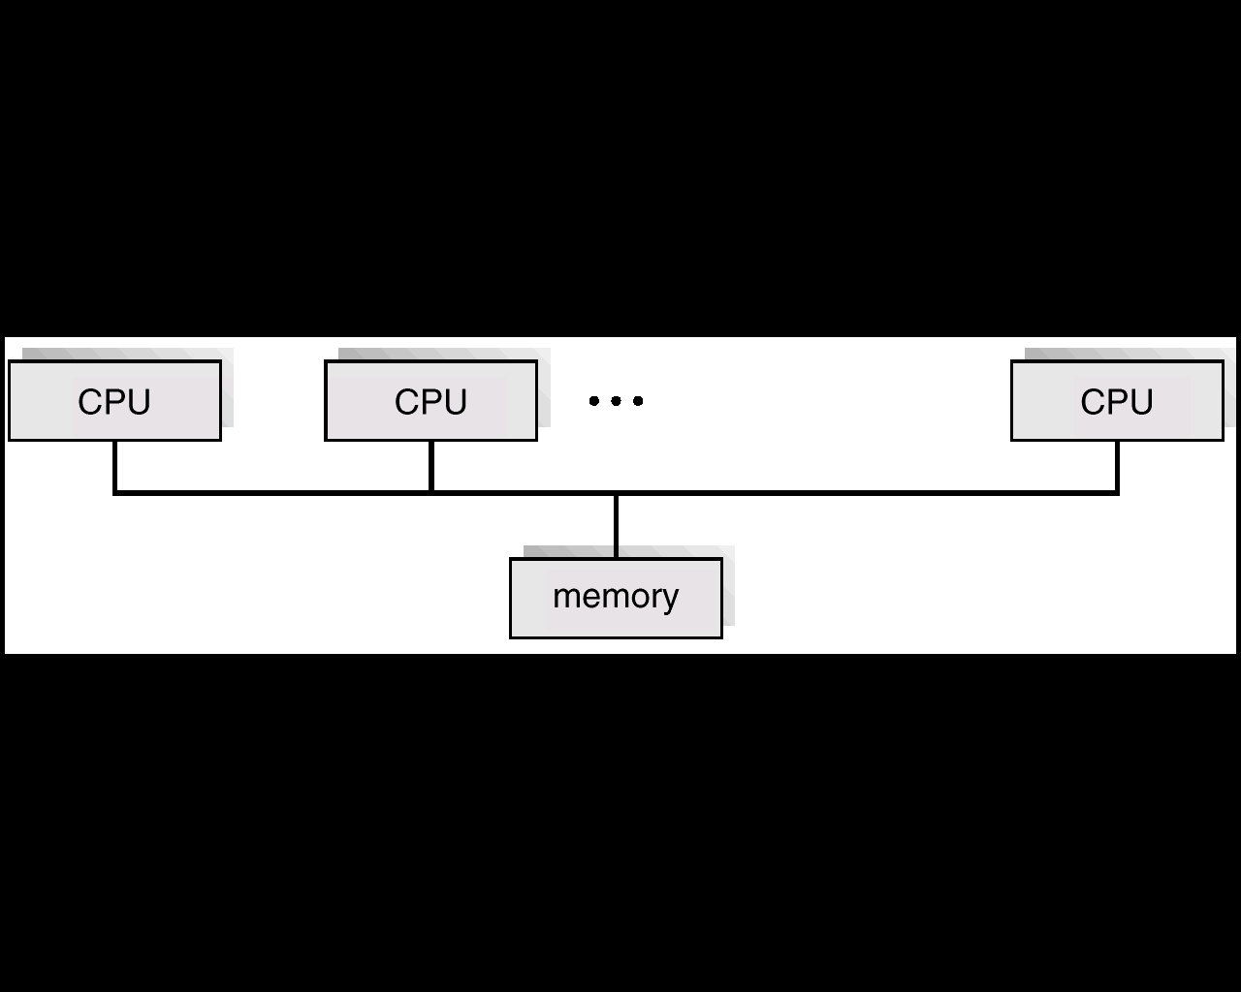
SMP architecture
The following figure shows SMP architecture.
The differences between symmetric & asymmetric multiprocessing may be result from either hardware or software. Special hardware can differentiate the multiple processors, or the software can be written to allow only one master & multiple slaves.

Slide 20
SMP architecture
A recent trend in CPU design is to include multiple compute cores on a single chip.
Blade Servers are recent development in which multiple processor boards, I/O boards, and networking boards are placed in same chassis. Here each processors can boot independently and run their own OS.

Slide 21
Clustered Systems
The clustered systems have multiple CPUs but they are composed of two or more individual systems coupled together.
Clustered systems share storage and are closely linked via LAN Network.
Clustering is usually used to provide high availability.
A layer of software cluster runs on the cluster nodes. Each node can monitor one or more of the others. If the monitored machine fails, the monitoring machine takes ownership of its storage and restarts the applications that were running on failed machine.

Slide 22
Clustered Systems
Clustered systems can be categorized into two groups
Asymmetric Clustering.
Symmetric clustering.
In asymmetric clustering one machine is in hot standby mode while others are running the application. The hot standby machine does nothing but it monitors the active server. If the server fails the hot standby machine becomes the active server.
In symmetric mode two or more hosts are running the application & they monitor each other. This mode is more efficient since it uses all the available hardware.

Slide 23
Clustered Systems
Other forms of clusters include parallel clusters and clustering over WAN.
Parallel clusters allow multiple hosts to access the same data on shared storage.
To provide this shared access, system must also supply access control and locking to ensure that no conflicting operations occur. This function known as distributed lock manager (DLM) is included.
Clustering provides better reliability than the multiprocessor systems.

Slide 24
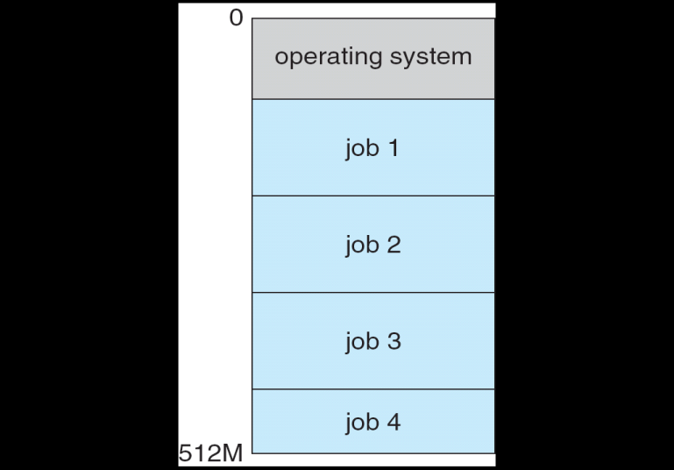
Operating System Structure
Multiprogramming system
Single user cannot keep CPU and I/O devices busy at all times.
Multiprogramming increases CPU utilization by organizing jobs so that CPU always has one to execute.
The OS has to keep several jobs in memory simultaneously as shown in below figure shown below
Memory layout for multiprogramming system

Slide 25
Operating System Structure
The OS picks up and starts executing one of the jobs.
Eventually if this job may not need the CPU due to some reason like, an I/O operation to complete, then in non multiprogrammed system CPU would sit idle.
But in a multiprogrammed system instead of having the CPU idle the OS switches to the next job in the memory.

Slide 26
Timesharing (multitasking)
It is a logical extension of multiprogramming in which CPU switches among jobs so frequently that users can interact with each job while it is running, creating interactive computing.
Allows many users to share the computer simultaneously.
It requires an interactive system or a hands-on computer system that provides direct communication between the user and the system.
Response time should be less than 1 second.
Each user has at least one program executing in memory.
A program loaded into memory and executing is called a process.
Timesharing and multiprogramming requires several jobs to be kept simultaneously in memory.

Slide 27
Timesharing (multitasking)
Job scheduling: A job pool consists of all processes residing on disk and awaiting allocation of main memory. If several jobs are ready to be brought into memory and if there is not enough room for them, then the system must choose among them. Making this decision is Job scheduling.
CPU scheduling: If several jobs are ready to run at the same time, then the system must choose among them. Making this decision is CPU scheduling.
Swapping: In time shared system processes are swapped in and out of main memory into the disk to ensure reasonable response time. A common method for achieving this is Virtual memory. The main advantage of the virtual-memory scheme is that it enables users to run programs that are larger than actual physical memory.

Slide 28
Operating System Operations
Modern OS is Interrupt driven.
Events are signaled by interrupt or trap.
An exception or trap is a software generated interrupt either by an error. (For ex: Division by zero) or specific request from a user program.
Dual-mode operation
To ensure proper execution of the OS, we must be able to distinguish between OS code and user defined code.
Most computer systems provide hardware support to differentiate among various modes of execution.

Slide 29
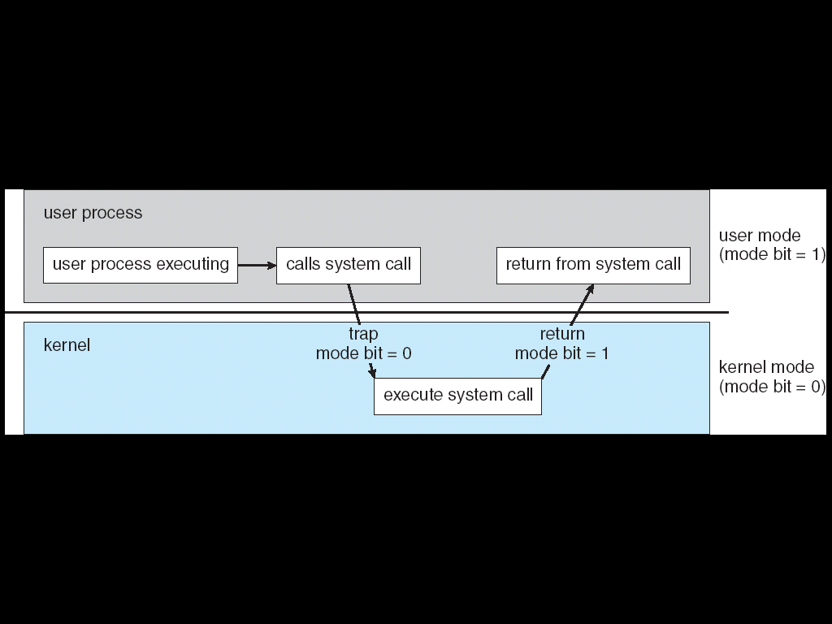
Operating System Operations
Two modes of operation are:
User mode
kernel mode (also called supervisor, system or privileged mode)
Mode bit is added to the hardware to indicate current mode User mode(1) and kernel mode(0).
When system is executing on behalf of user application, the s/m is in user mode.
When a user application requests a service from OS, it must transit from user to kernel mode to fulfill the request as shown in figure.

Slide 30
Operating System Operations
At system boot time, the hardware starts in kernel mode. The OS is then loaded and starts user applications in user mode. Whenever a trap or interrupt occurs, the hardware switches from user mode to kernel mode. Thus, whenever the OS gains control of the computer, it is in kernel mode. The system always switches to user mode before passing control to user program.
The hardware allows privileged instructions to be executed only in kernel mode. If an attempt is made to execute privileged instructions in user mode, the hardware does not execute it but rather treats it as an illegal and traps it to the OS. Examples: Instruction to switch to user mode, I/O control instructions, timer management instructions and interrupt management instructions.

Slide 31
Operating System Operations
Timer
Timer is used to prevent a program from getting stuck in an infinite loop or not calling system services and never returning control to the OS.
Timer can be set to interrupt the computer after a specific period.
The period may be fixed or variable. The variable timer is implemented by fixed rate clock and a counter. Whenever the clock ticks, operating system decrements the counter. When counter reaches zero it generates an interrupt.
Timer has to be set before scheduling process to regain control or terminate program that exceeds allotted time.

Slide 32
Memory Management
Main memory is the central to the operation of the computer system.
Main memory is the large array of words or bytes, ranging in size from hundreds of thousands to billions. Each word or byte will have their own address.
The CPU reads the instruction from main memory during instruction fetch cycle & during the data-fetch cycle it reads & writes the data.
The main memory is the only storage device in which a CPU is able to address & access directly.
For a program to be executed, it must be loaded into memory & mapped to absolute addresses. When the program terminates, all available memory will be returned back.

Slide 33
Memory Management
To improve the utilization of CPU & the response time several programs will be kept in memory.
Several memory management schemes are available & selection depends on the Hardware design of the system.
The OS is responsible for the following activities
Keeping track of which parts of the memory are used & by whom.
Deciding which process and data to move into and out of memory.
Allocating & deallocating memory space as needed.

Slide 34
Storage Management
File System Management
File management is one of the most visible components of an OS.
Computer can store information on different types of physical media like Magnetic Disks, Magnetic tapes, optical disks etc.
These devices have their own unique characteristics like access speed, capacity, data transfer rate, and access method (sequential or random).
OS implements the abstract concept of a file by managing mass storage media like tapes, disks etc.,

Slide 35
Storage Management
A file is a collection of related information defined by its creator. They commonly represent programs (source and object) and data. Data files may be numeric, alphabetic or alphanumeric.
Files can be organized into directories to make them easier to use.
The OS is responsible for the following activities,
Creating & deleting files.
Creating & deleting directories.
Supporting primitives for manipulating files & directories.
Mapping files onto secondary storage.
Backing up files on stable (non-volatile) storage media.

Slide 36
Storage Management
Mass Storage management
Computer system must provide secondary storage to back up main memory because,
It is too small to accommodate all data and programs.
Data held in this memory is lost when power goes off.
Most programs including compilers, assemblers, word processors, editors etc are stored on the disk until loaded into the memory and then use disk as both source and destination of processing. Hence proper management of disk storage is very important.

Slide 37
Storage management
The OS is responsible for the following activities,
Free space management.
Storage allocation.
Disk scheduling.
Slower and low cost but high-capacity backup storage devices are called tertiary devices which are used for back-up of the regular disk data, seldom used data, long term archival storage etc.
Example. Magnetic tapes and their drives, CD and DVD drives and
platters like tape and optical platters.

Slide 38
Storage Management
Caching
It is an important principle of a computer system and is a fast memory which is used for storing information on a temporary basis.
First, the cache is searched when a particular piece of information is required during processing. If the information already available, then it is directly used from the cache, otherwise we use information from the source, putting a copy in the cache, under the assumption that we will need the information again very soon.
Internal programmable registers like index registers can be used as high-speed cache for the main memory.
Caches have limited size and thus Cache management is an important design problem.

Slide 39
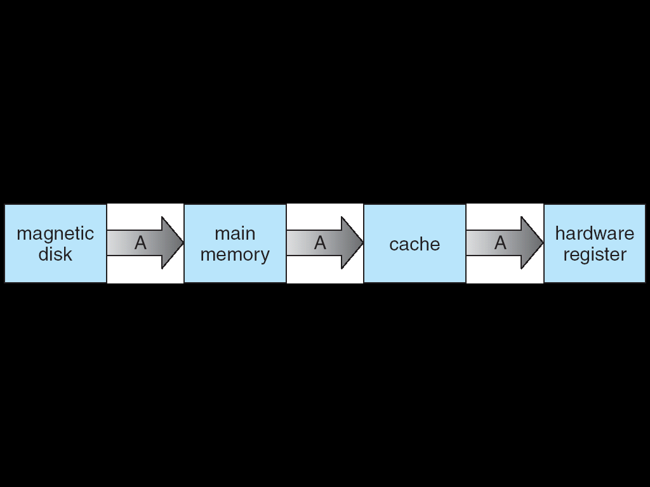
Storage Management
In a hierarchical storage structure, the same data may appear in different levels of storage system. For ex, Suppose that an integer A is to be incremented by 1 is located in file B which resides on disk, the migration of integer A from Disk to Register is shown in below figure.
Once the increment to A takes place in the internal registers, the value of A differs in various storage systems. The value of A becomes same only after the new value of A is written from the internal register back to the disk.

Slide 40
Storage Management
In multitasking environments, extreme care must be taken to use most recent value, not matter where it is stored in the storage hierarchy.
The situation becomes more complicated in multiprocessor environment, where each CPU is associated with local cache. A care must be taken to make sure that an update to the value of A in one cache is immediately reflected in all other caches. This situation is called as cache coherency.
The situation becomes even more complex in a distributed environment. Several copies of the same file can be kept on different computers. Since the various replicas may be accessed and updated concurrently, some distributed systems ensure that, when a replica is updated in one place all other replicas are also updated as soon as possible.

Slide 41
Storage Management
I/O Systems
OS hides peculiarities of hardware devices from the user.
I/O subsystem consists of several components like,
The memory management component that includes buffering, caching and spooling.
A general device driver interface.
Drivers for specific hardware devices.
Only the device driver knows the peculiarities of each of the devices.

Slide 42
Protection and Security
A protection mechanism is required to regulate access to data.
System resources are made available to only those processes which have gained authorization from OS.
Protection
The mechanism must specify the controls to be imposed.
The advantages of providing protection are:
It can improve reliability
Early detection prevents corruption of good subsystems
Protection can prevent misuse by an unauthorized or incompetent user.

Slide 43
Protection and Security
The security system must defend the system from external and internal attacks. Attacks can be of various types like viruses, worms, denial-of-service attack, identity theft, theft of service etc. Ex. If a user’s authentication information is stolen then the owner’s data can be stolen, corrupted or deleted.
The mechanism of protection and security must be able to distinguish among all its users. This is possible because the system maintains a list of all user ids. These ids are unique per user.
When it is required to distinguish among a set of users rather than individual users then group functionality is implemented.
A system-wide list of group names and group ids are stored.

Slide 44
Protection and Security
If a user needs to escalate privileges for gaining extra permissions then different methods are provided by the OS.

Slide 45
Distributed Systems
A distributed system is a collection of physically separate heterogeneous computer.
A distributed system communicate & coordinate their actions only by-passing messages.
Distributed systems depend on networking for their functionality.
A network operating system is an OS that provides features such as file sharing and exchange messages.

Slide 46
Distributed Systems
The advantages of Distributed Systems are,
Resource sharing
Higher reliability
Better price performance ratio
Shorter response time
Higher throughput
Incremental growth

Slide 47
Special Purpose Systems
The special purpose computers are those whose functions are more limited and whose objectives are to deal with limited computation domains.
Examples. Realtime Embedded Systems, Multimedia Systems and Handheld Systems.
Real- Time Embedded Systems
Embedded computers are found almost everywhere from car engines, robots, alarm systems, medical imaging systems, industrial control systems, microwave ovens, weapon systems etc.
This class of computers have very specific task and run an OS with very limited features. Usually they have limited or no user interface.
Embedded systems runs on real time OS.

Slide 48
Special Purpose Systems
A real time system should have well defined, fixed time constraints. Processing must be done within the defined constraints or the system will fail. Hence they are often used as controlled device in a dedicated application.
Real time systems are of two types
Hard Real Time Systems
Soft Real Time Systems
A hard real time system guarantees that the critical tasks to be completed on time.
In soft real time system is a less restrictive one where a critical real time task gets priority over other tasks & retains the property until it completes.

Slide 49
Multimedia Systems
A recent trend in technology is the incorporation of multimedia data.
Multimedia data consists of audio and video files along with conventional files(text files, word document, etc).
The difference from conventional data is that the multimedia data must be delivered or streamed according to some time restrictions.
Multimedia applications include video conferencing, news stories download over the internet, live webcasts of speeches and so on.

Slide 50
Handheld Systems
Handheld systems include Personal Digital Assistants (PDAs), Cellular telephones, palm and pocket PCs and so on,
Drawbacks are, because of smaller size they have small amount of memory, slow processors and small display screen.
Memory-Because of small size, OS and applications must manage the memory efficiently. Many handheld devices do not use virtual memory techniques.
Speed-Processors run at a fraction of the speed of the PC processor. Faster processors require more power. Therefore, OS and applications must not tax the processor.
The small display screen also limits the output options.

Slide 51
Handheld Systems
Advantages are
Ability to synchronize with desktops.
Small size hence can be carried around easily.

Slide 52
Computing Environments
Traditional Computing
Client Server Computing
Peer-to-Peer Computing
Web based Computing

Slide 53
Computing Environments
Traditional Computing
Consider the “typical office environment”: Few year’s back it consisted of PCs connected to the network with servers providing file and print service, Remote access looked tough and portability was achieved through laptop.
Terminals attached to mainframes were common at many companies with even few remote access and portability option.
The web technologies are stretching the boundaries of traditional computing. Companies have portals, which provide web access to their internal servers. Network computers are terminals that understand the web based computing. Hand held PDAs can also connect to wireless networks to use company’s web portal.

Slide 54
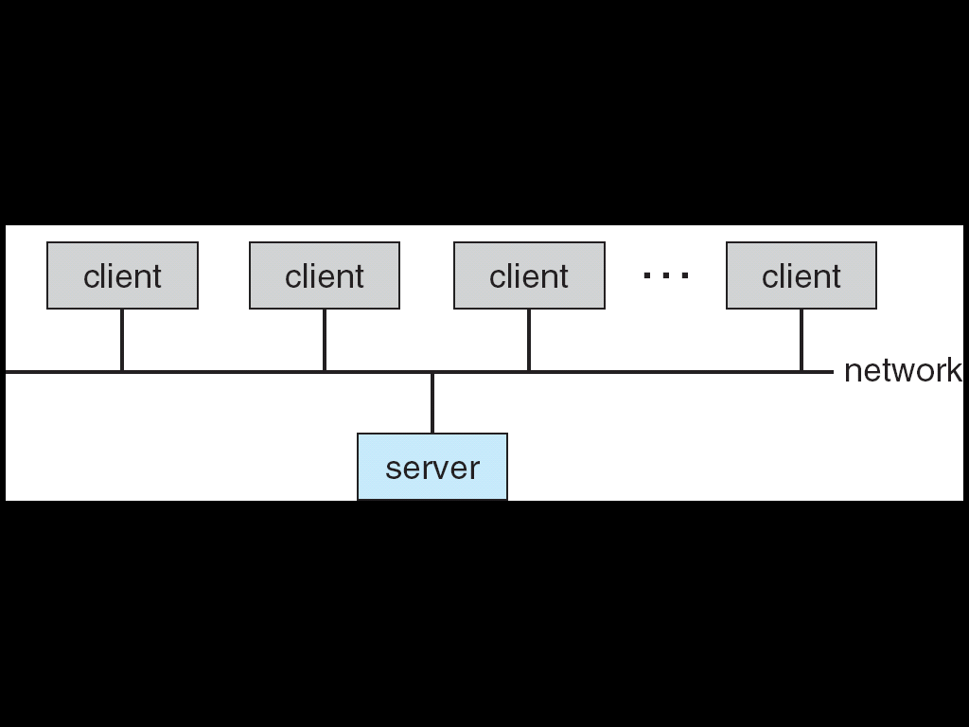
Computing Environments
Client-Server Computing
Many of today’s systems act as server systems to satisfy requests of clients.
This form of specialized distributed system, called client-server system has general structure as shown in below figure

Slide 55
Computing Environments
Server system can be classified as follows
Compute-Server Systems:
Ex. A server running a database that responds to client requests for data.
File-Server Systems:
Ex. A web server that delivers files to clients running web

Slide 56
Computing Environments
Peer-to-Peer(P2P) Computing
It is another form of a distributed system. Here, clients and servers are not distinguished from one another.
All nodes within the system are considered as peers. Each can act as a server or a client depending on who is requesting or providing a service.
The advantage is the removal of bottleneck as the services can be provided by several nodes that are distributed throughout the network.
To participate in a P2P system a node must first join the network of peers. On joining, the new node can provide and request for services.

Slide 57
Computing Environments
Determining what services are available in the network can be accomplished in one of two methods,
When a node joins a network, it registers its services with a centralized lookup service on the network. Any node wants service, first contacts the centralized lookup service to determine which nodes provides the service. Then the communication takes place between the client and the service provider.
A peer which is a client broadcasts a request for service to all nodes in the network. The nodes that provide the service responds to the requesting peer. A discovery protocol is used by the peers to discover the services provided by other peers.

Slide 58
Computing Environments
Web Based Computing
It leads to more access by wider variety of devices other than PCs workstations, PDAs, and cell phones.
Web computing has increased the emphasis on networking.
Devices that were not previously networked have been wired or wireless nowadays.
The network connectivity is faster through improved network technology and optimized network implementation code.
Web based computing has given rise to a new category of devices called load balancers which distribute network connections among a pool of similar servers.

Slide 59
Operating System Structure
Operating System Services
An OS provides an environment for the execution of the programs. The common services provided by the OS are:
User interface
Program Execution
I/O Operation
File System manipulation
Communication
Error Detection
Resource Allocation
Accounting
Protection and security

Slide 60
Operating System Structure
User interface: Almost all operating systems have a user interface (UI). This interface can take several forms.
Command-line interface (CLI)
Batch Interface
Graphical User Interface (GUI)

Slide 61
Operating System Structure
2. Program Execution: The OS must able to load the program into memory & run that program. The program must be able to end its execution either normally or abnormally.
3. I/O Operation: A running program may require I/O( file or an I/O device). Users cannot control the I/O devices directly. So the OS must provide a means for controlling I/O devices.
4. File System manipulation: Program needs to read and write files and directories. They also need to create and delete files, search for a given file and list file information. Some programs include permission management to deny access to files or directories based on file ownership.

Slide 62
Operating System Structure
5. Communication: In certain situation one process may need to exchange information with another process. This communication may takes place in two ways.
Between the processes executing on the same computer.
Between the processes executing on different computer that are connected by a network.
Communications can be implemented via shared memory or by message passing, in which packets of information are moved between processes by the OS.

Slide 63
Operating System Structure
6. Error Detection: Errors may occur in CPU, I/O devices or in Memory Hardware. The OS constantly needs to be aware of possible errors. For each type of errors the OS should take appropriate actions to ensure correct & consistent computing.
7. Resource Allocation: When multiple users logs onto the system or when multiple jobs are running, resources must be allocated to each of them. The OS manages different types of OS resources. Some resources may need some special allocation codes & others may have some general request & release code.

Slide 64
Operating System Structure
8. Accounting: We need to keep track of which users use how many & what kind of resources. This record keeping may be used for accounting. This accounting data may be used for statistics or billing. It can also be used to improve system efficiency.
9. Protection and security: Protection ensures that all the access to the system are controlled. Security starts with each user having authenticated to the system, usually by means of a password. External I/O devices must also be protected from invalid access. In multi process environment it is possible that one process may interface with the other or with the OS, so protection is required.

Slide 65
User Operating-System Interface
User Operating-System Interface
There are two fundamental approaches for users to interface with OS,
Command Interpreter
Graphical User Interface
1. Command Interpreter(CI)
Some OS include CI in the kernel, and in others like windows-XP and UNIX, it is treated as a special program that is running when a job is initiated or when a user first logs on.
On systems with multiple command interpreters to choose from, the interpreters are known as shells. For ex: On UNIX and Linux systems, there are different shells a user may choose from including Bourne shell, C shell and K or n shell etc
The main function of the command interpreter is to get and execute the next user-specified command.

Slide 66
User Operating-System Interface
Commands are implemented in two ways:
In one approach, the command interpreter itself has the code to execute the command. Ex. a command to delete a file. This will result in the command interpreter to go to a section of its code that sets up the parameters and makes the appropriate system call. In this method, the size of the command interpreter depends on the number of commands that can be given.
Alternative approach used by UNIX is most commands are implemented through system programs. The command interpreter uses the command to identify a file to be loaded into memory and executed. Ex. rmfile.txt would make the command interpreter search for a file rm, load that file into memory and execute it with parameter file.txt.

Slide 67
User Operating-System Interface
Advantages of CIs are,
Command interpreter program is small.
Command interpreter does not have to be changed when new commands are added.
New commands can be easily added to the system.

Slide 68
Graphical User Interface
GUI provides user-friendly desktop metaphor interface where the mouse is moved to position where images or icons on the desktop that represent programs, files directories and other system functions.
Depending on mouse pointer’s location, clicking the mouse button can invoke the corresponding program, select a file or directory known as folders or pull down a menu that contains commands.
First appeared in 1970s as a part of research at Xerox Parc research facility.

Slide 69
Graphical User Interface
It became widespread with the coming of Apple Macintosh in 1980s.
Microsoft’s first version of Windows was based on GUI interface for MS-DOS. The various windows systems that have been appeared and had enhancements in the GUI.
UNIX later implemented GUI in CDE (Common Desktop Environment) and X-Windows Systems. Also seen in Solaris and IBM’s AIX system.

Slide 70
SYSTEM CALLS
System provides interface to the services made available by an OS.
These calls are generally available as routines written in C and C++, although certain low-level tasks may need to be written using assembly language instruction.
System call sequence to read the contents of one file and copy to another file is illustrated in below figure shown below

Slide 71
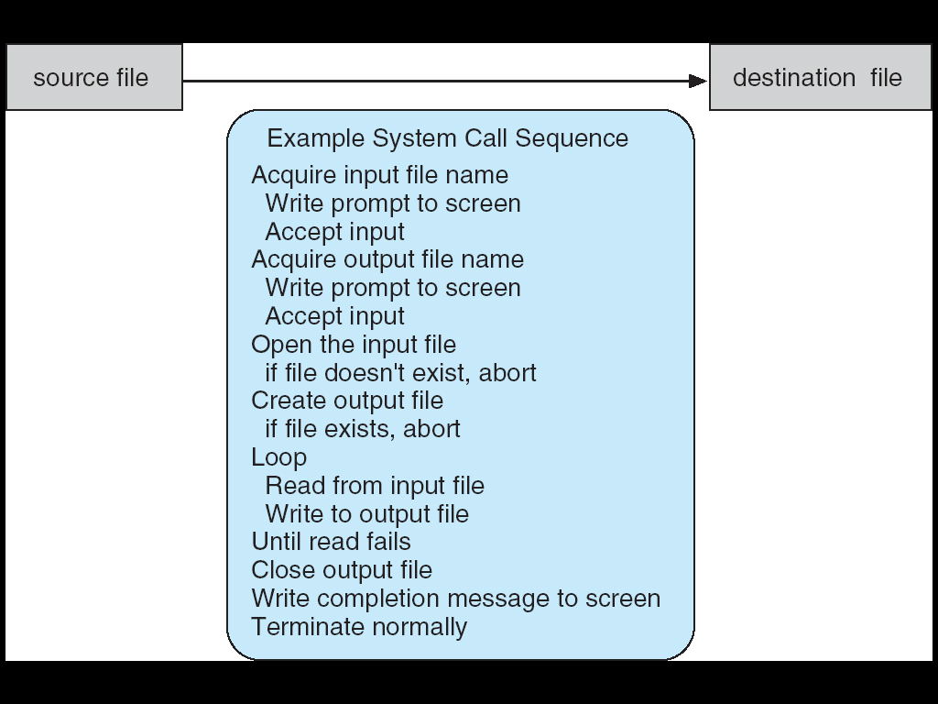
SYSTEM CALLS

Slide 72
SYSTEM CALLS
The first input that the program will need is the names of two files which can be specified in many ways. This sequence requires many I/O system calls.
Next, the program must open the input file which requires another system call. If opening of file fails, it should display error message on console (another system call) and should terminate abnormally (another system call).
Next, the program must create the output file (another system call), If fails, it should display error message on console (another system call) and should also abort (another system call).

Slide 73
SYSTEM CALLS
Next, we enter a loop that reads from input file (system call) and writes to the output file (system call).Write/read operation may fail, which needs another system call to continue.
Finally, after the entire file is copied, the program may close both files (system call), write message to console (system call)), and terminate normally (system call).

Slide 74
SYSTEM CALLS
Application developers design programs according to an Application Program Interface (API).
Three most common APIs are:
1. Win32 API for Windows,
2. POSIX API for POSIX-based systems (UNIX, Linux, and Mac OS X), and
3. Java API for the Java virtual machine (JVM).
The runtime support system for most programming languages provides a system call interface that serves as the link to system calls made available by the OS.

Slide 75
SYSTEM CALLS
The system call interface intercepts function call in the API and invokes the necessary system call within the OS.
A number is associated with each system call and the system-call interface maintains a table indexed according to these numbers.
The system call interface invokes intended system call in OS kernel and returns status of the system call and any return values.
The caller needs to know nothing about how the system call is implemented or what it does during execution.

Slide 76
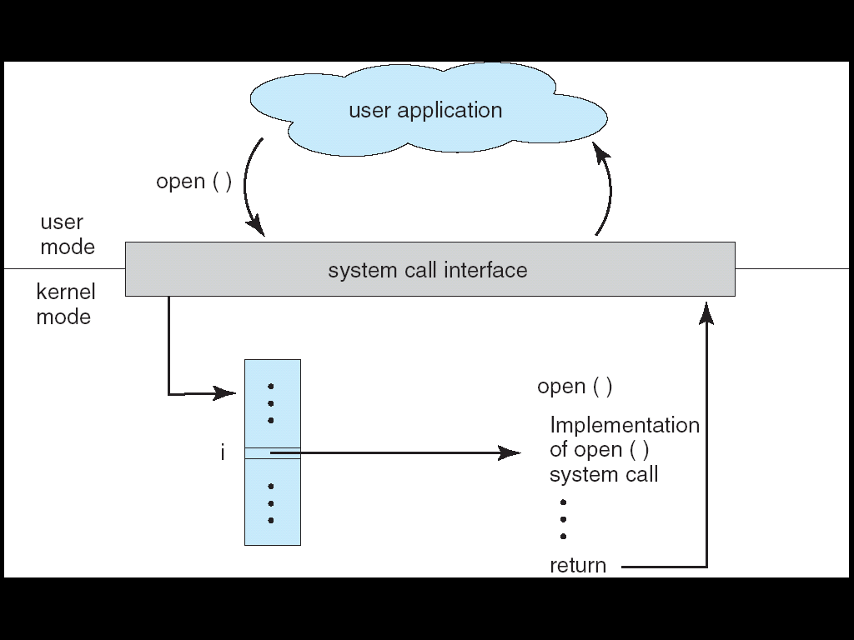
SYSTEM CALLS
The below figure illustrates how the OS handles a user application which is invoking open () system call

Slide 77
SYSTEM CALLS
Three general methods are used to pass the parameters to the OS.
The simplest approach is to pass the parameters in registers.
In some cases there can be more parameters than registers. In these cases the parameters are stored in a block or table in memory and the address of the block is passed as a parameter in register. It is shown in below figure This approach is used by Linux and Solaris.
Parameters can also be placed or pushed onto stack by the program &popped off the stack by the OS.

Slide 78
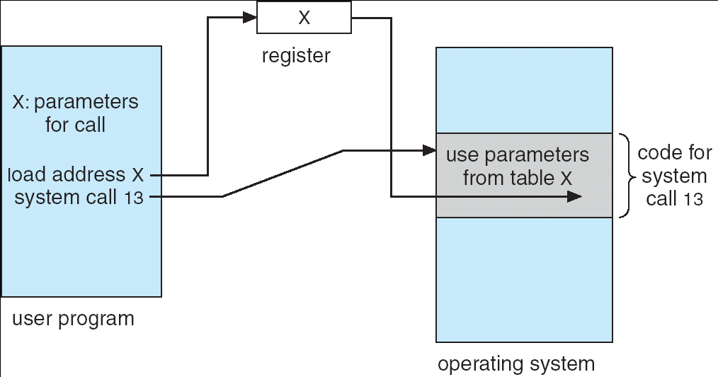
SYSTEM CALLS

Slide 79
TYPES OF SYSTEM CALLS
System calls may be grouped roughly into 5 categories
Process control
File management
Device management
Information maintenance
Communications

Slide 80
1. Process control
The command used are:
end, abort –
load, execute –
create process, terminate process –
wait event, signal event –
get process attributes, set process attributes –
wait for time –
allocate and free memory –

Slide 81
2. File Management
The command used are:
create file, delete file
open, close file
read, write, reposition
get and set file attributes

Slide 82
3. Device Management
The commands used are:
request device, release device
read, write, reposition
get device attributes, set device attributes
logically attach or detach devices

Slide 83
4. Information Maintenance
The commands used are:
get time or date, set time or date
get system data, set system data
get and set process, file or device attributes

Slide 84
5. Communications
The commands used are:
create, delete communication connection
send, receive messages
transfer status information
attach and detach remote devices

Slide 85
Inter process communications
The Two models of Inter-process communication:
1. Message passing model
2. Shared memory model

Slide 86
System Programs
It provides a convenient environment for program development and execution.
The can be divided into 6 categories
File management
Status management
File modification
Programming language support
Program loading and execution
Communications

Slide 87
Application programs
Most OS are supplied with application program.
Such application programs are: word processors, text formatters, spreadsheets, database systems, compilers, plotters & statistical analysis packages and games.

Slide 88
Operating System Design & Implementation
Design goals:
Goals & Specification
Mechanism and Policies
Implementation
The system design will be affected by
Hardware & type of system like timesharing, batch, distributed, real time, single user, multiuser operating system or general purpose.
The Requirements can be divided into 2 basic groups:
a) User goals.
b) System goals.

Slide 89
Mechanism and Policies
Mechanisms
Policy
Example: timer construct is a mechanism to ensure CPU protection whereas for how long the timer is to be set for a particular user is a policy decision.

Slide 90
Implementation
OS have been written in assembly language.
MS-DOS was implemented in intel 8088 and was available in Intel CPUs only.
Master Control Program(MCP) written in ALGOL, MULTICS in PL/I and Linux is with C & available on Intel 8086.
Now they are most commonly written in higher level languages such as c or c++.
OS is easier to port.
Disadvantage of OS in high level language is reduced speed and increased storage requirements.

Slide 91
Operating System Structures
Modern OS is large & complex.
Different types of structures used are:
Simple Structures
Layered Approach
Micro Kernels.

Slide 92
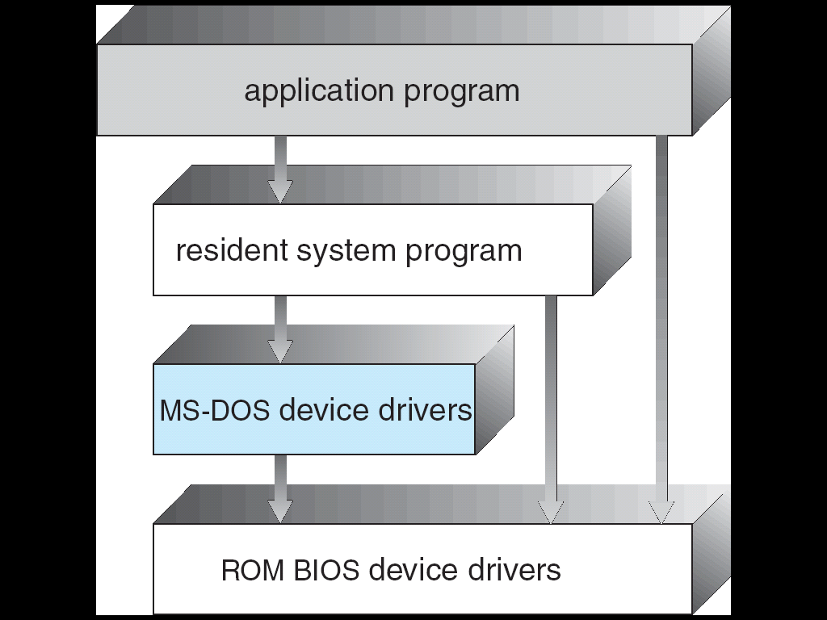
1. Simple Structures
Simple Structure OS are small, simple & limited sytems.
Example: MS-DOS

Slide 93
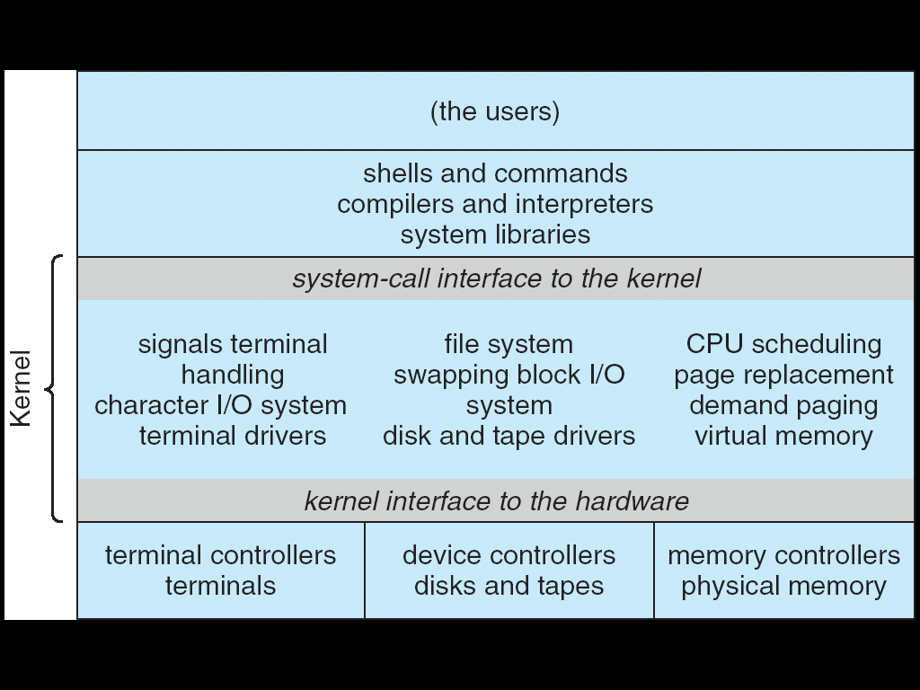
Example: UNIX

Slide 94
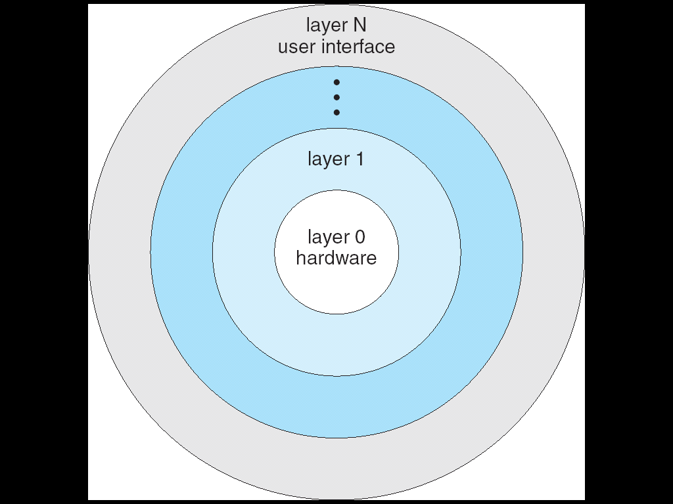
Layered Approach
OS is divided into number of layers.

Slide 95
Micro Kernels
In 1980 Mach OS has been developed.
The main functions to provide communication facilities.
High degree of flexibility and modularity.
New services are added and provides more security and reliability.
Provides portability and Modularity.

Slide 96
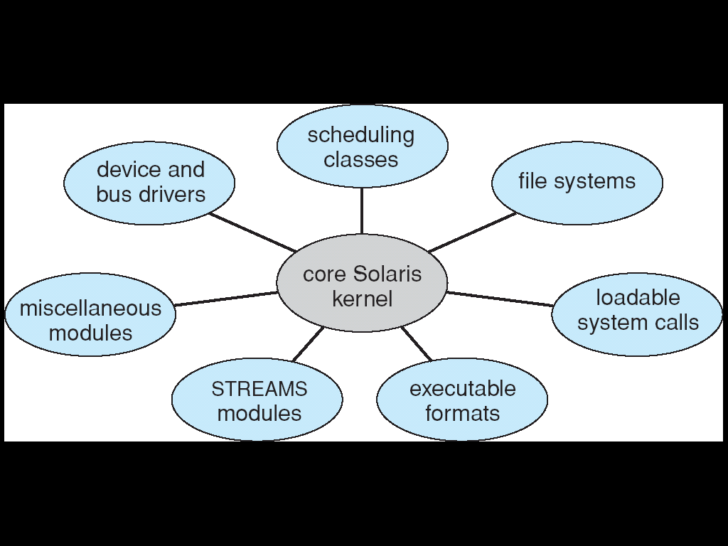
Modules
Best methodology for OS design involves suing OOP techniques to create a modular kernel.
Set of core components and links
Solaris OS structure is shown below.

Slide 97
Modules
Seven types of loadable kernel modules:
Scheduling classes
File Systems
Loadable system calls
Executable formats
STREAMS modules
Miscellaneous
Device and bus drivers

Slide 98
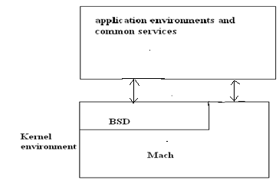
Structure of Mac OSX
Structure of Mac OSX appear as shown below.

Slide 99
Virtual Machines
A virtual machine is to abstract the hardware of a single computer into several different execution environment.
A Virtual machine is an OS that is installed on software, which initiates dedicated hardware.
It creates an illusion that a process has its own processor.
Below figure shows each process is provided with a copy of underlying computer.

Slide 100
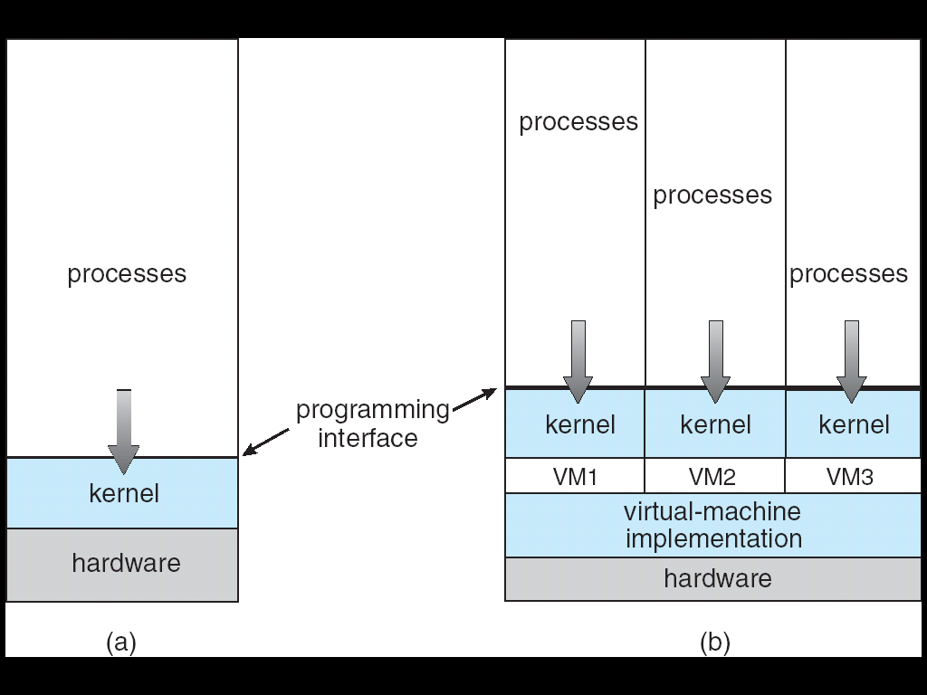
Virtual machine

Slide 101
Implementation
Difficult to implement VM Concept.
The machine has 2 modes: user mode & Kernel mode
The VM software can run in kernel mode, since it is the OS.
The major difference between Virtual and non Virtual machine is time.

Slide 102
Benefits
The virtual-machine concept provides complete protection of system resources since each virtual machine is isolated from all other virtual machines.
A virtual-machine system is a perfect vehicle for operating-systems research and development.
System programmers are given their own VM, and system development is done on the virtual machine instead on a physical machine.
Example : VMware and java virtual machine

Slide 103
Examples
VMware
It is a popular commercial application that abstracts Intel X86 and compatible hardware into isolated virtual machines.
It runs as an application on a host operating system such as Windows or Linux and allows this host system to concurrently run several different guest operating systems as independent virtual machines.
2. Java Virtual Machine
Java is a popular object-oriented programming language introduced by Sun Microsystems in 1995.
In addition to a language specification and a large API library, Java also provides a specification for a Java virtual machine-or JVM.
Java objects are specified with the class construct. A Java program consists of one or more classes. For each Java class, the compiler produces an architecture-neutral byte code output (.class) file that will run on any implementation of the JVM.

Slide 104
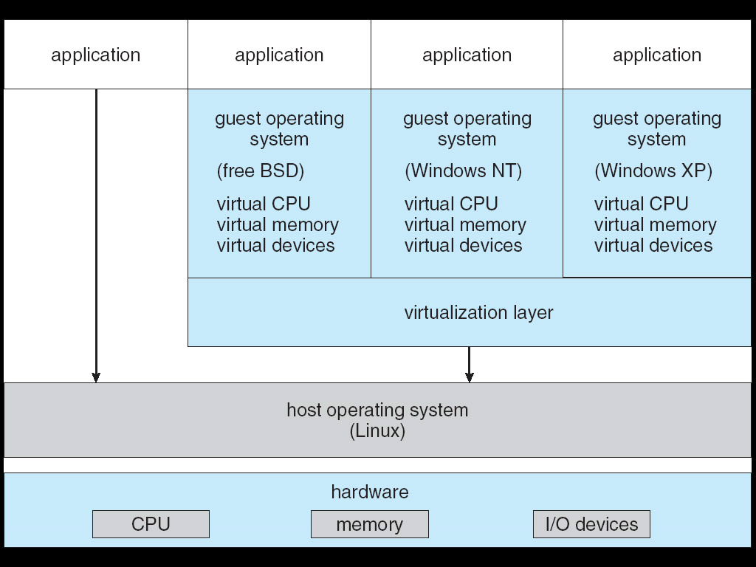
Examples
VMware
The architecture is shown below figure.

Slide 105
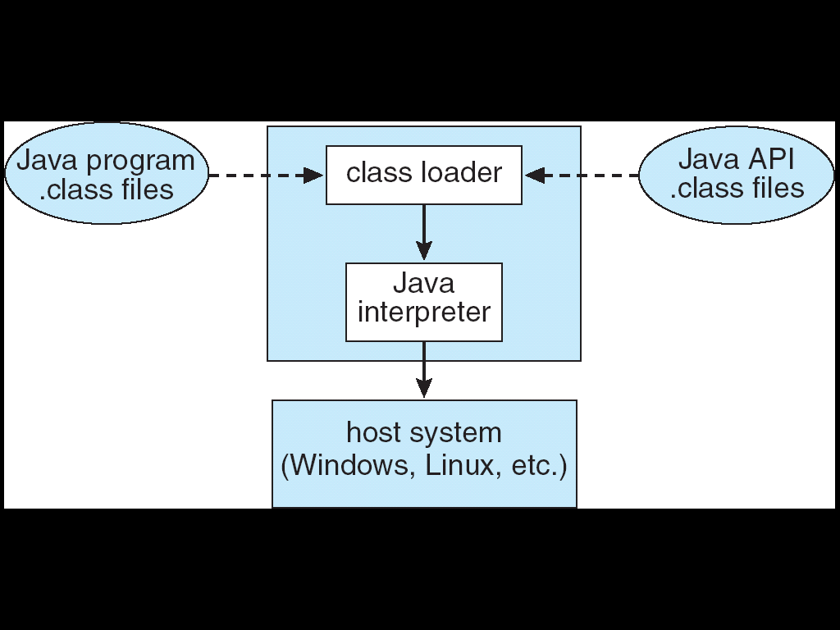
Examples
2. Java Virtual Machine
The JVM is a specification for an abstract computer. It consists of a class loader and a Java interpreter that executes the architecture-neutral byte codes, as given in below figure

Slide 106
System Boot
The procedure of starting a computer by loading the kernel is known as booting the system.
Bootstrap program or Bootstrap loader locates the kernel, loads it into main memory and start its execution.
Bootstrap program is in the form of read only memory (ROM)
All forms of ROM are knows as firmware.
For large OS like Windows, Mac OS, the Bootstrap loaders is stored in firmware and the OS is on disk.
Bootstrap has a bit code to read a single block at a fixed location from disk into the memory and execute the code from that boot block.
A disk that has a boot partition is called a boot disk or system disk.

Slide 107
Process Management
Process Concepts
Process is an active entity.
A process is a sequence of instruction execution.
Process exists in a limited span of time.
Two or more process may execute the same program by using its own data & resources.
A program is a passive entity which is made up of program statement.
Program contains instructions.

Slide 108
Process Management
The Process
A process is more than the program code which is also called text section.
It contains program counter which represents the current activity and also the contents of the processor's registers.
A process also consists of a process stack section which contains temporary data &data section which contains global variables.
A process may also include a heap, which is memory that is dynamically allocated during process run time.

Slide 109
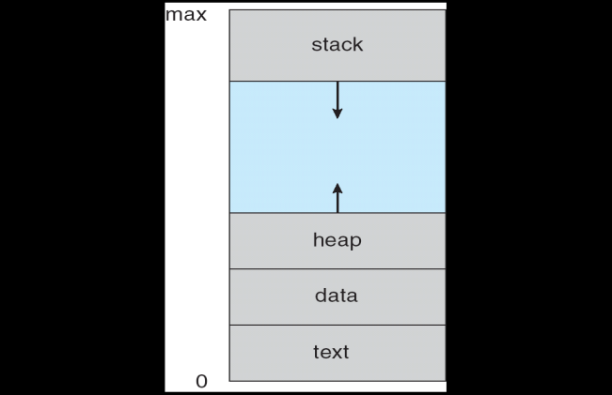
Process Management
The structure of a process in memory is shown in below figure.

Slide 110
Process Management
Process State
As process executes it changes its state and each process may be in one of the following states:
New: The process is being created
Running: Instructions are being executed
Waiting: The process is waiting for some event to occur
Ready: The process is waiting to be assigned to a process
Terminated: The process has finished execution

Slide 111
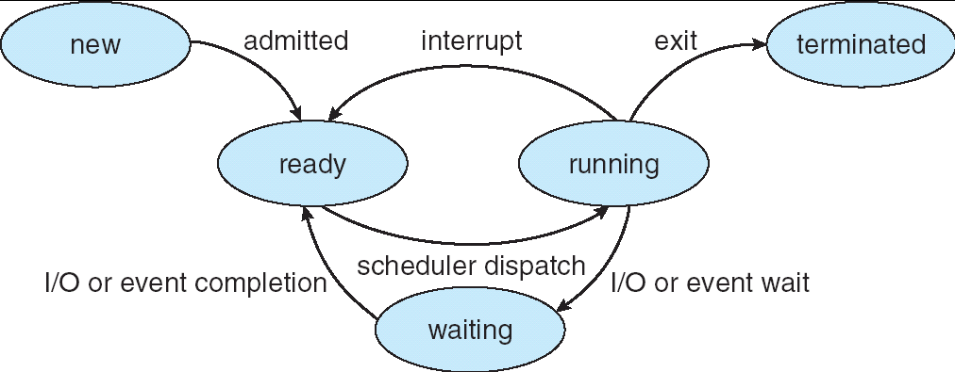
Process Management
Only one process can be running on any processor at any instant. Many processes may be ready and waiting.
The state diagram corresponding to these states is shown below figure.

Slide 112
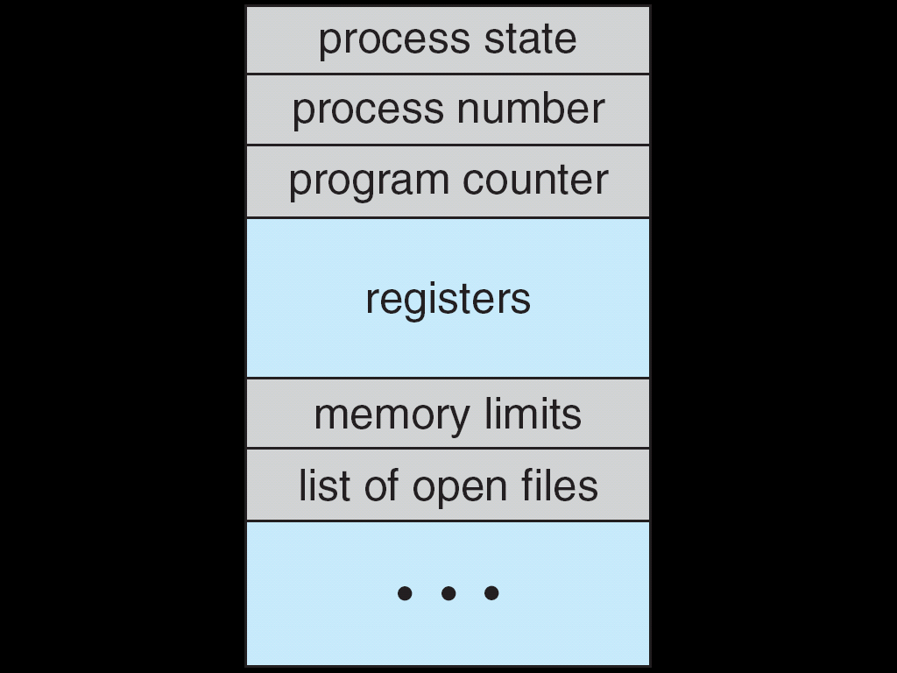
Process Control Block
A process in an operating system is represented by a data structure known as a Process Control Block (PCB).
The following figure shows the process control block.

Slide 113
Process Control Block
The PCB contains important information about the specific process including,
Process state
Program counter
CPU registers
CPU scheduling information
Memory-management information
Accounting information
I/O status information

Slide 114
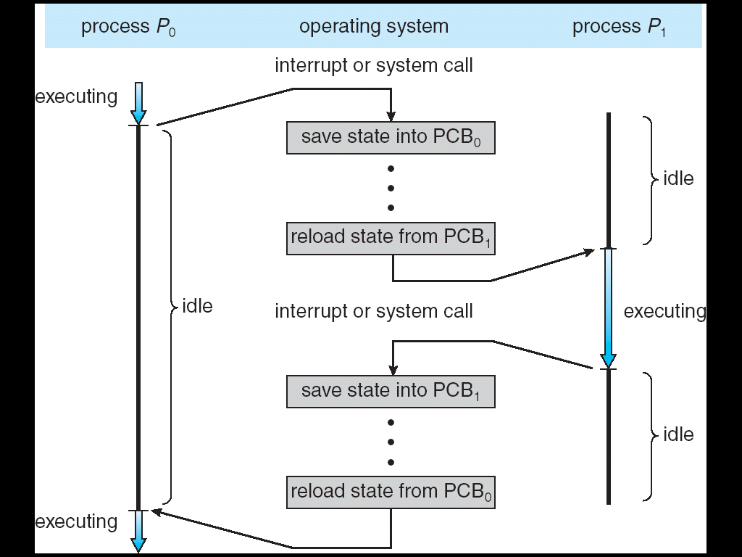
Process Control Block
CPU switch from process to process

Slide 115
Threads
A process is a program that performs a single thread of execution.
For example, when a process is running a word-processor program, a single thread of instruction is being executed.
Many modern operating systems have extended the process concept to allow a process to have multiple threads of execution and thus to perform more than one task at a time.
For example: Windows OS and UNIX.

Slide 116
Process Scheduling
The process scheduler selects an available process for execution on the CPU.
Scheduling queues
The following are the different types of process scheduling queues.
Job queue
Ready queue
Device queue

Slide 117
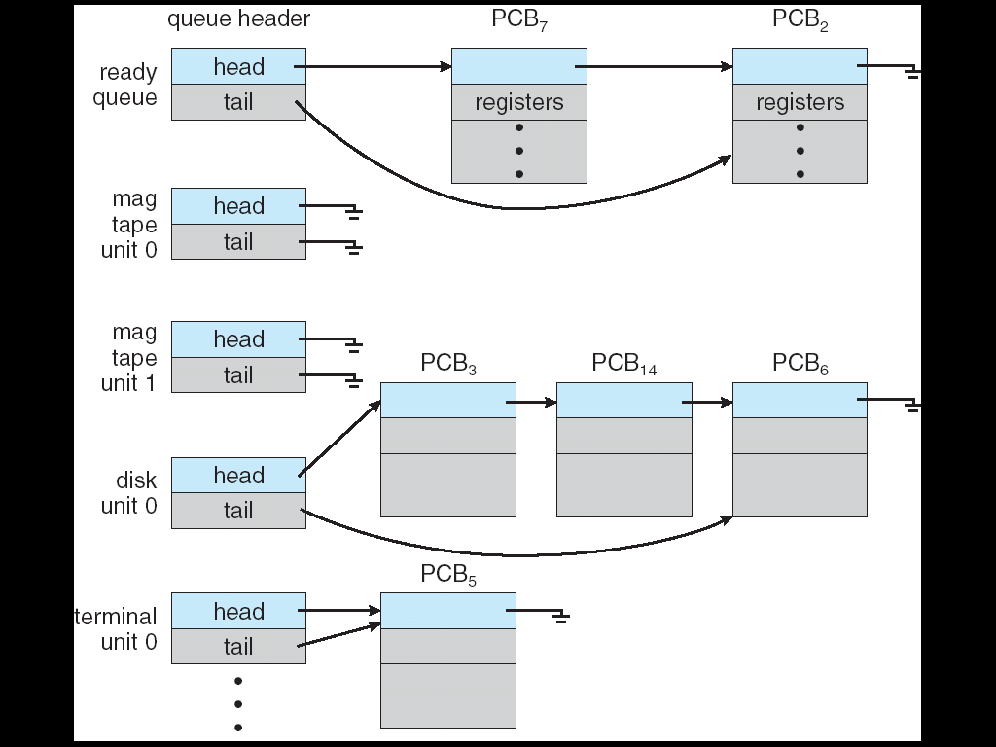
Process Scheduling
The below figure. Shows Ready queue and various I/O Device queues.

Slide 118
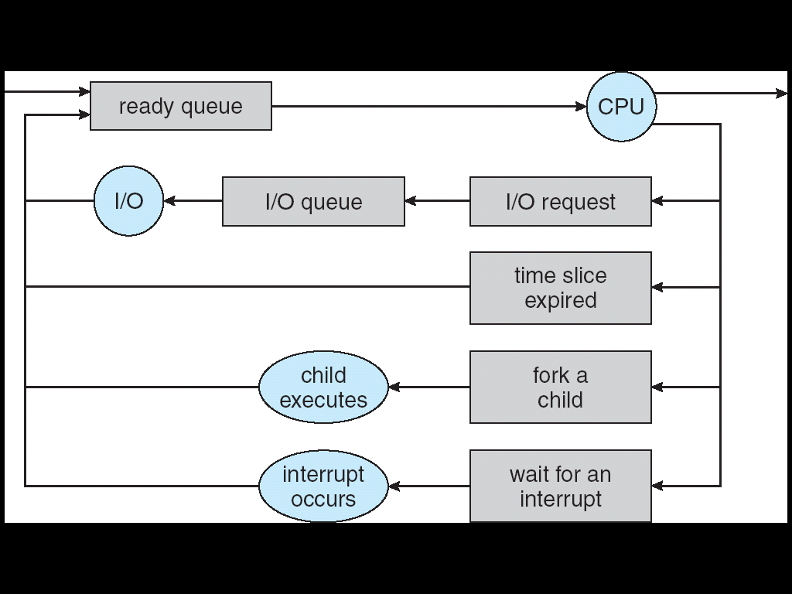
Process Scheduling
The process scheduling is represented using a queuing diagram as shown in below figure.

Slide 119
Process Scheduling
A new process is initially put in the ready queue and it waits there until it is selected for execution or dispatched. Once the process is assigned CPU and is executing, the following events can occur,
It can execute an I/O request and is placed in I/O queue.
The process can create a sub process & wait for its termination.
The process may be removed from the CPU as a result of interrupt and can be put back into ready queue.

Slide 120
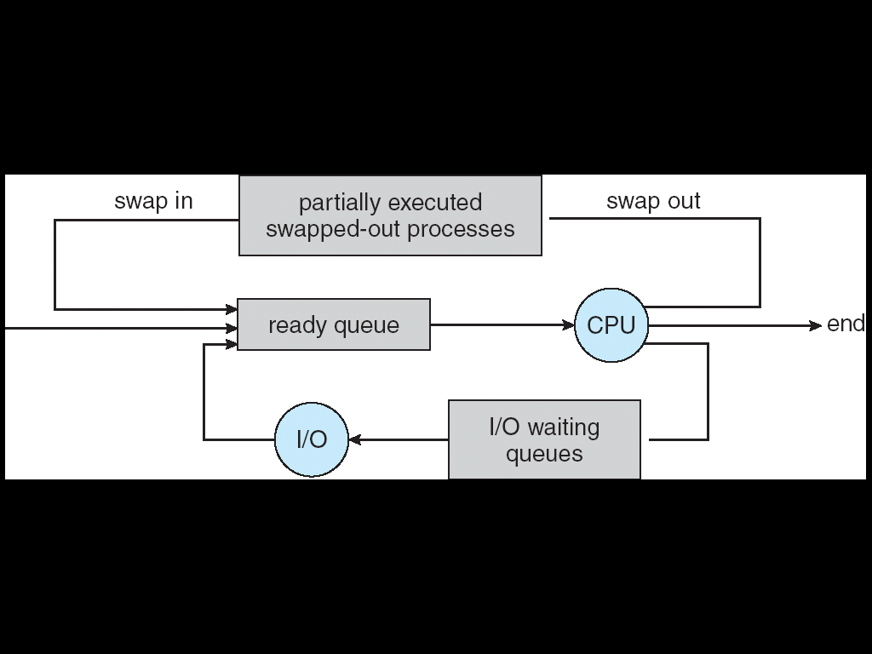
Process Scheduling
Schedulers
The following are the different types of schedulers,
Long-term scheduler (or job scheduler)
Short-term scheduler (or CPU scheduler)
Medium-term schedulers

Slide 121
Process Scheduling
Processes can be described as either:
I/O-bound process: processes spend more time doing I/O than computations.
CPU-bound process: processes spend more time doing computations; and generates I/O request less frequently.

Slide 122
Process Scheduling
Context Switch
Context-switch time is overhead and the system does no useful work while switching.
Context-switch times are highly dependent on hardware support.
Context-switch speed varies from machine to machine, depending on the memory speed, the number of registers that must be copied, and the existence of special instructions.

Slide 123
Process Operation
The processes in most systems can execute concurrently, and they may be created and deleted dynamically. Thus, these systems must provide a mechanism for process creation and termination.
Process Creation
A process may create several new processes by some create-process system call, during the course of execution.
The creating process is called parent process and the created one is called the child process. Each of the new process may in turn create other processes, forming a tree of processes. Processes are identified by unique process identifier ( or pid).

Slide 124
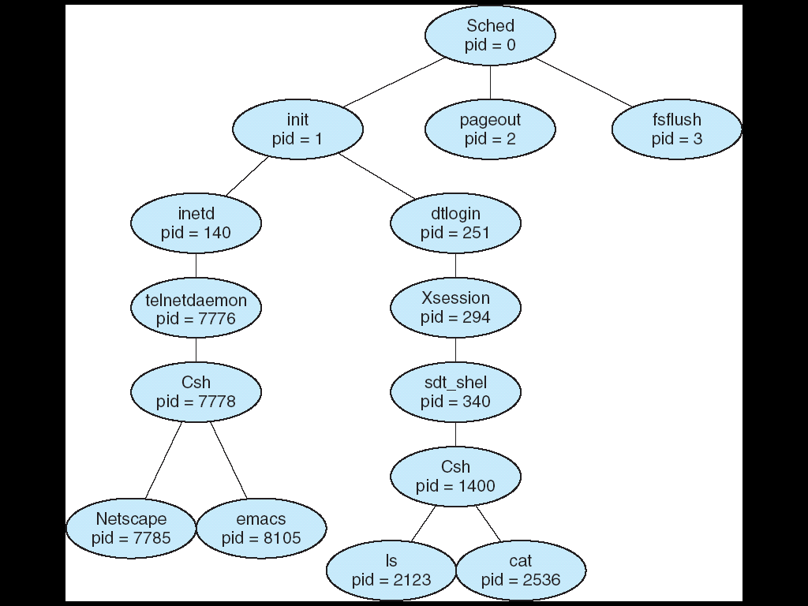
Process Operation
Below Figure. shows the process tree for the solaris OS.

Slide 125
Process Operation
When a process creates a new process, two possibilities exist in terms of execution.
The parent continues to execute concurrently with its children
The parent waits until some or all of the children have terminated.
There are also two possibilities in terms of the address space of the new process.
1. The child process is a duplicate of the parent process.
2. The child process has a new program loaded into it.

Slide 126
Process Operation
In UNIX OS, fork () system call creates new process. In windows Create Process() does the job.
Exec () system call is called after a fork () to replace the process memory space with a new program.

Slide 127
Process Operation
The C program shown below illustrates these system calls.
int main()
{
Pid_t pid;
pid = fork();/* fork another process */
if (pid < 0)/* error occurred */
{
fprintf(stderr, "Fork Failed");
exit(-1);
}
else if (pid == 0) /* child process */
{
execlp("/bin/ls", "ls", NULL);
}
else /* parent process */
{
wait (NULL);/* parent will wait for the child to complete */
printf ("Child Complete");
exit(0);
}
}

Slide 128
Interprocess Communication
Processes executing concurrently in the operating system may be either independent processes or cooperating processes.
A process is independent if it cannot affect or be affected by the other processes executing in the system. Any process that does not share data with any other process is independent.
A process is cooperating if it can affect or be affected by the other processes executing in the system. Any process that shares data with other processes is a cooperating process.

Slide 129
Interprocess Communication
Advantages:
Information sharing
Computation speed-up
Modularity
Convenience

Slide 130
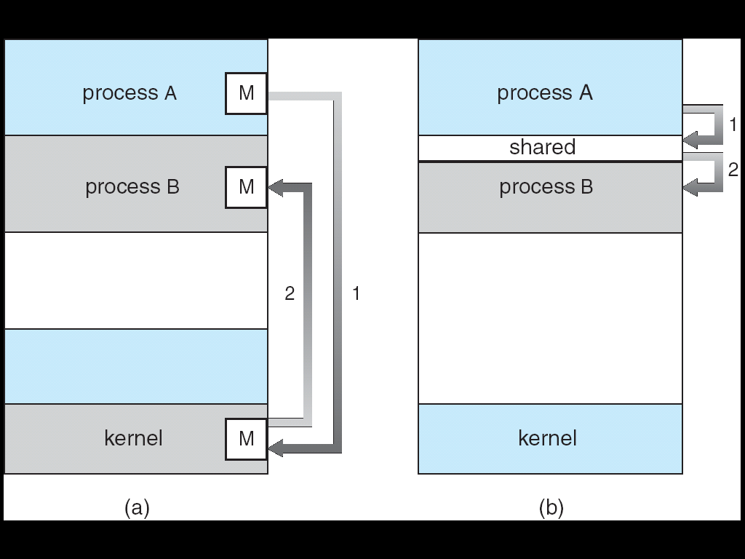
Interprocess Communication
There are two fundamental models of IPC as shown in figure.
Shared memory
Message Passing

Slide 131
Interprocess Communication
The differences between these two models are,
Message passing | Shared memory
a. Useful for exchanging small amount of data. | a. large data
b. easy to implement | b. complex
c. Slower | c. faster
d. implemented using system calls | d. system calls are required only to establish Shared memory region

Slide 132
Interprocess Communication
Shared Memory System
A region of memory that is shared by cooperating processes is established. Processes then exchange information by reading and writing data to the shared region.
To illustrate cooperating processes, consider producer-consumer problem.
Producer process produces information that is consumed by a consumer process.
One solution to producer-consumer problem uses shared memory. To allow producer and consumer processes to run concurrently, there must be a buffer of items that can be filled by a producer and emptied by consumer. The buffer will reside in a shared memory region.

Slide 133
Interprocess Communication
Two types of buffers can be used.
Unbounded-buffer
Bounded-buffer
The following variables reside in a region of memory shared by the producer and consumer processes
#define BUFFER_SIZE 10
typedef struct {
……..
……..
}item;
item buffer[BUFFER_SIZE];
int in = 0;
int out = 0;

Slide 134
Interprocess Communication
The code for the producer process is shown below.
item nextProduced;
while (true)
{
/* produce an item in nextProduced */
while ( ((in + 1) % BUFFER_SIZE) = = out); //do nothing
buffer[in] = nextProduced;
in = (in + 1) % BUFFER_SIZE;
}
The code for the consumer process is shown below.
item nextConsumed;
while (true)
{
while (in = = out); //do nothing
nextConsumed = buffer[out];
out = (out + 1) % BUFFER_SIZE;
/* consume the item in nextConsumed */
}

Slide 135
Interprocess Communication
Message Passing System
Communication takes place by means of message exchange between the cooperating processes.
Message passing facility provides two operations.
Send (message)
Receive (message)
Message size can be fixed or variable.

Slide 136
Interprocess Communication
If P and Q wish to communicate, they need to establish a communication link between them and communication link can be,
physical (eg: shared memory, hardware bus)
logical (eg: logical properties)
Several methods for logically implementing a link are,
Direct or Indirect communication
Synchronous or asynchronous communication
Automatic or explicit buffering

Slide 137
Interprocess Communication
Naming
Processes that want to communicate must have a way to refer to each other. They can use either direct or indirect communication.
Under Direct Communication processes must name each other explicitly
The send() and receive() primitives are defined as,
Send (P, message) – send a message to process P.
Receive (Q, message) – receive a message from process Q.

Slide 138
Interprocess Communication
In Indirect Communication messages are sent and received from mailboxes (also referred to as ports)
A mailbox can be viewed abstractly as an object into which messages can be placed by processes and from which messages can be removed.
Each mailbox has a unique id and processes can communicate only if they share a mailbox.
The send() and receive() primitives are defined as,
Send (A, message) – send a message to mailbox A
Receive (A, message) – receive a message from mailbox A

Slide 139
Interprocess Communication
Properties of communication link are,
Links are established only if processes share a common mailbox.
A link may be associated with many processes.
Each pair of processes may share several communication links.
This scheme exhibits two types of addressing
Symmetry
Asymmetry
Send (P, message) – send a message to process P
Receive (id, message) – receive a message from any process

Slide 140
Interprocess Communication
OS allows the process to do the following operations
create a new mailbox
send and receive messages through mailbox
destroy a mailbox

Slide 141
Interprocess Communication
Synchronization
Message passing may be either blocking or non-blocking.
Blocking is considered synchronous.
Non-blocking is considered asynchronous.
Blocking send: The sending process is blocked until the message is received by the receiving process or by the mailbox.
Non-blocking send: The sending process sends the message and resumes operation.
Blocking receive: The receiver blocks until a message is available.
Non-blocking receive: The receiver retrieves either a valid message or a null.

Slide 142
Interprocess Communication
Buffering
Messages exchanged by communicating processes reside in a temporary queue, and such queues can be implemented in one of three ways,
Zero capacity
Bounded capacity – finite
Unbounded capacity – infinite

Slide 143
Thank you

